Slide 1
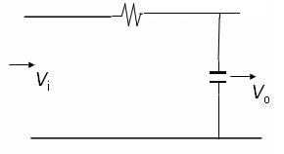
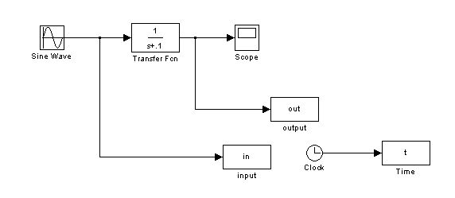
Sinusoidal steady-state response of circuits
When a linear circuit is subjected to a sinusoidal input, in steady state the output will be ……..
R=1ohm
C=0.1F

Slide 2
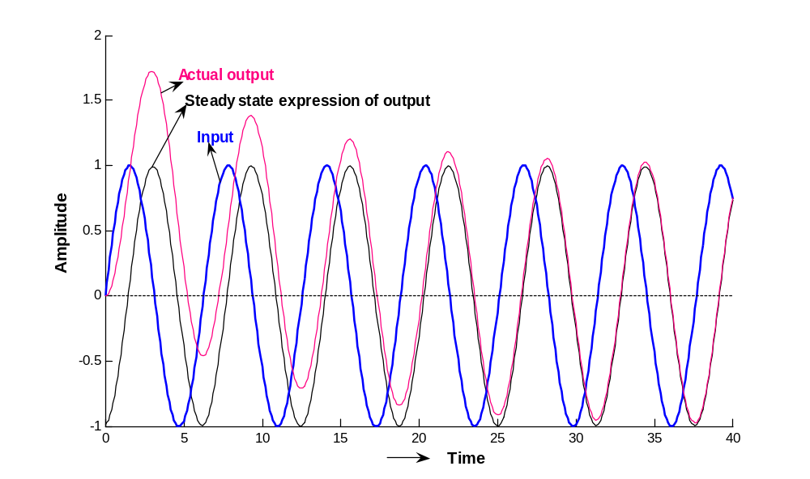
t=0:.1:40; b=atan(10); y=.9950*sin(t-b); plot(t,y) plot(t,in,t,out)

Slide 3
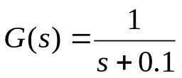
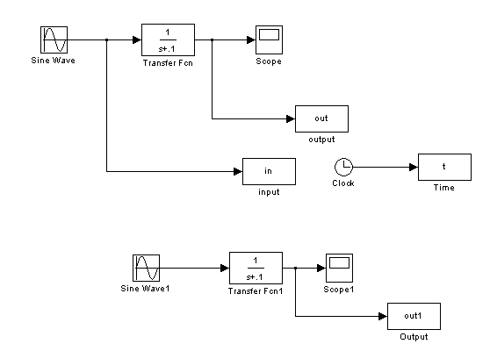
ω=50 rad/sec
Sinusoidal Response of system ( ) for two frequencies
ω=1 rad/sec

Slide 4
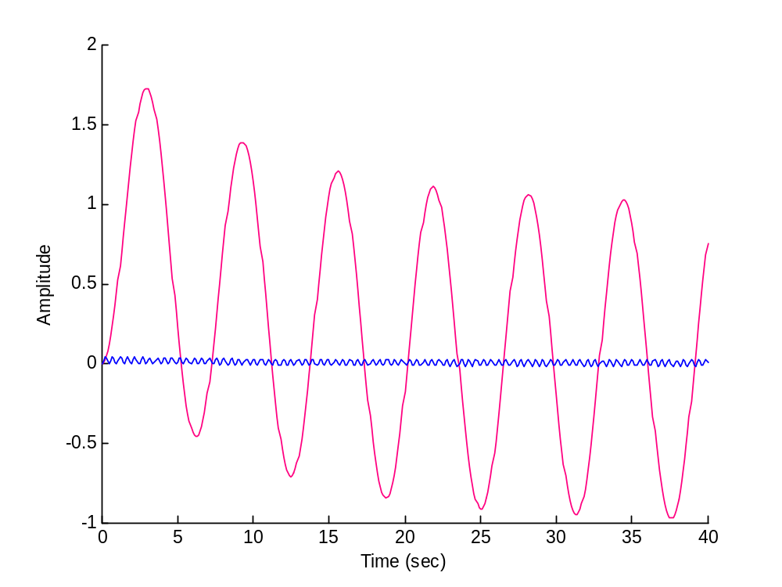
ω=1 rad/sec ω=50 rad/sec
Sinusoidal Response of system ( ) for two frequencies

Slide 5
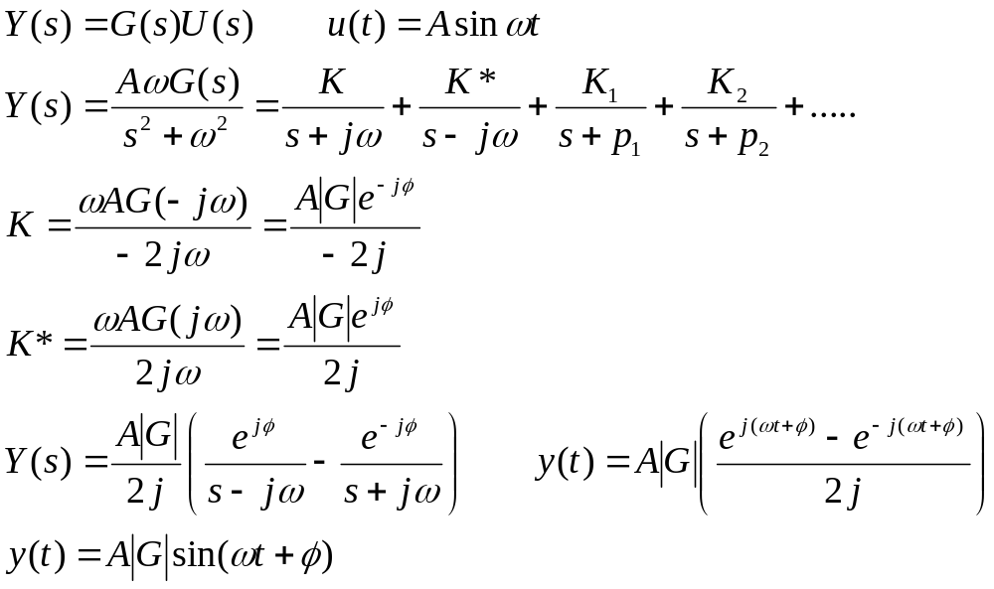
Steady State Response of Linear Systems to Sinusoidal Input

Slide 6
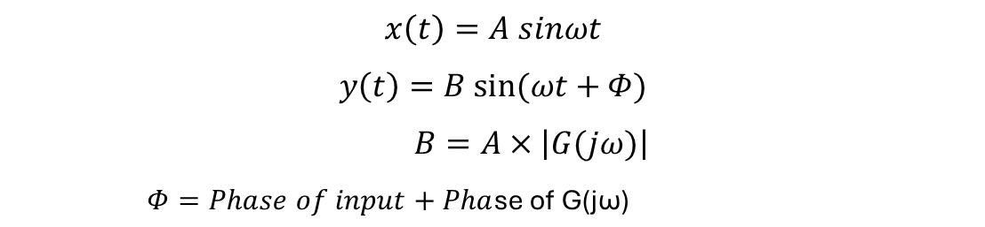


When a linear circuit is subjected to a sinusoidal input, in steady state, the output will be sinusoidal with a magnitude equal to the product of the input magnitude and the magnitude of G(jω) and phase is equal to the sum of the phases of the input and G(jω).
Bode plots consist of two graphs: one showing the magnitude (gain) and the other showing the phase shift, both plotted against frequency.
Bode plots use a logarithmic scale for frequency on the x-axis and decibels (dB) for magnitude on the y-axis.
This allows for the visualization of a wide range of frequencies and magnitudes, which is particularly useful
for analyzing the frequency response of circuits like filters.

Slide 7
Semi log graph

Slide 8


Rules for plotting Bode Plots
When G(s) = K
When G(s) = Ks
90°
20 dB
-90°

Slide 9
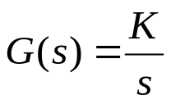






3. When the magnitude plot will cross 0 dB line at with a slope -20 dB/decade
90°

Slide 10
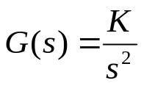




4. When the magnitude plot will cross 0 dB line at with a slope -40 dB/decade
180°

Slide 11
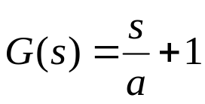
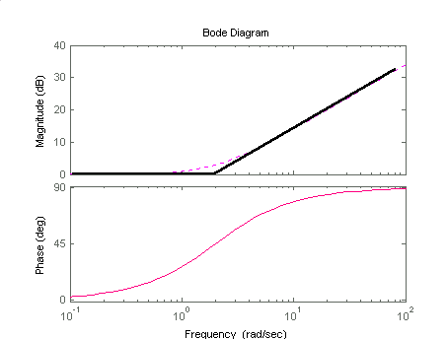


5 When dB magnitude is zero up to a
From a a line with slope +20 dB/decade

Slide 12
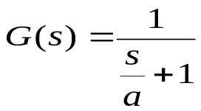
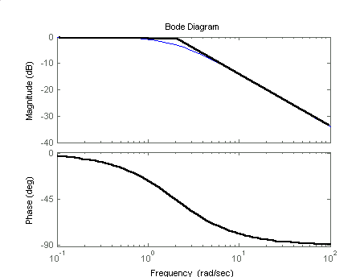

6 When dB magnitude is zero up to a
From a a line with slope -20 dB/decade

Slide 13
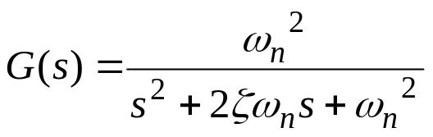
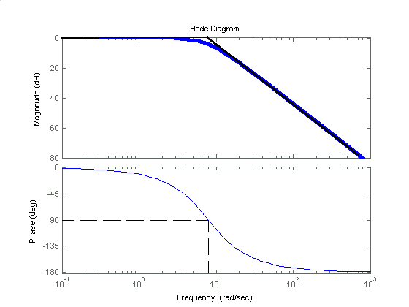


7

Slide 14
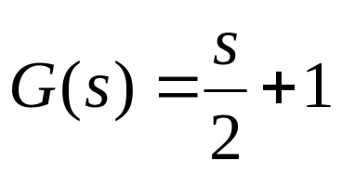
Draw approximate magnitude plot
20dB/Decade
20dB
0.1
1
2
10
20
100

Slide 15
5

Slide 16
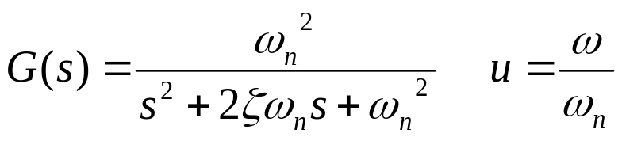
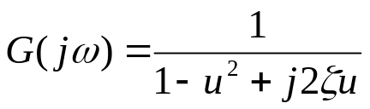
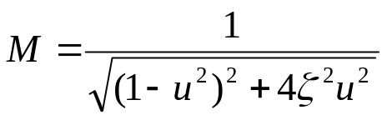
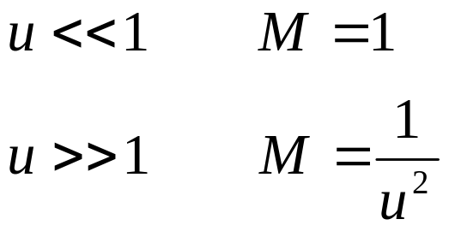
Gain in dB =20logM
Upto ω =ωn the magnitude plot is zero and then a line with slope 40dB/D

Slide 17
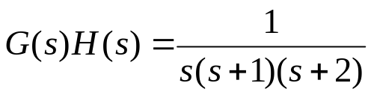
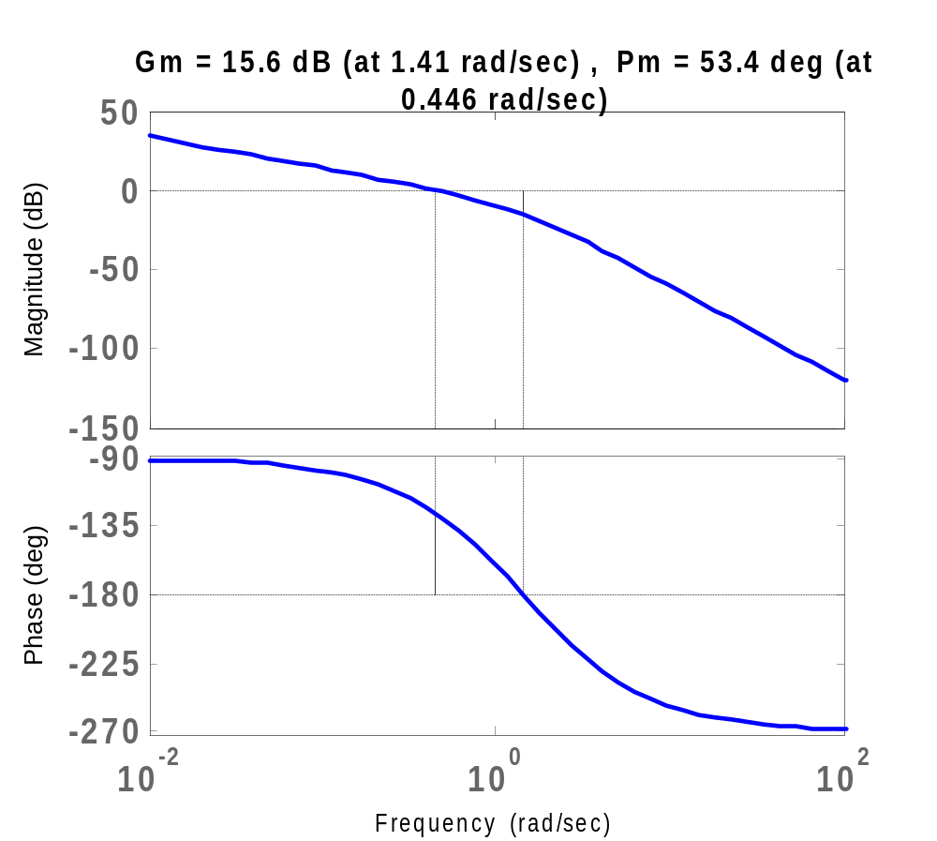
Bode plot of
-15.6
-126.6

Slide 18
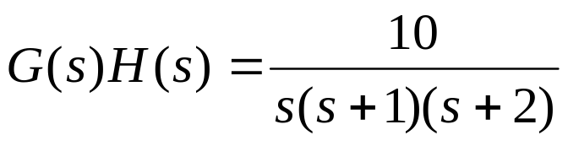
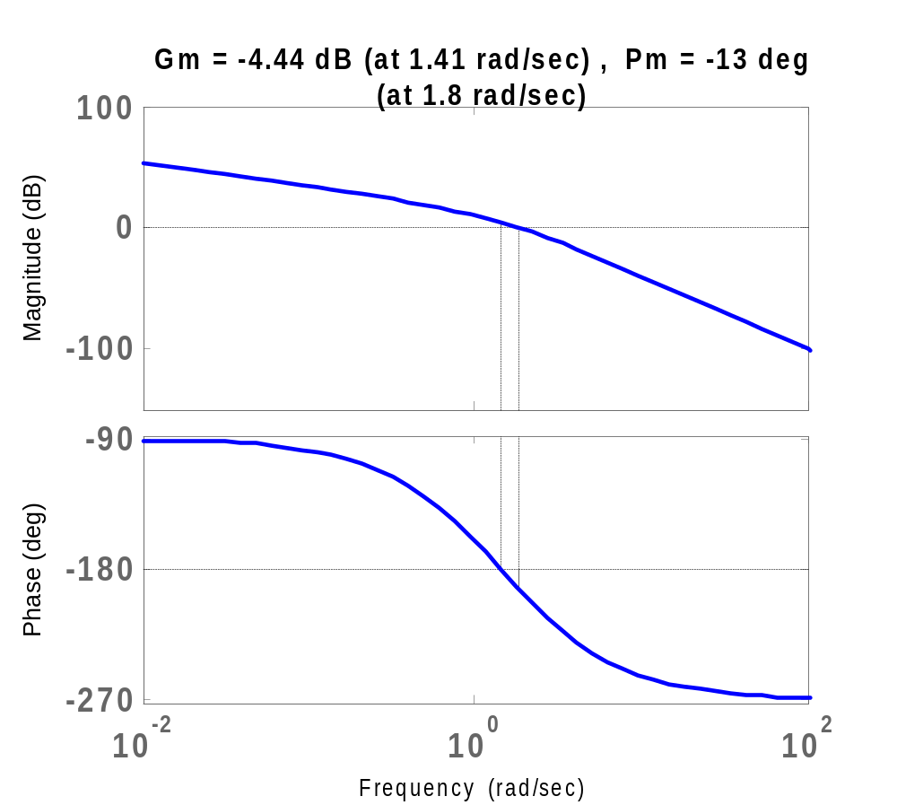
4.44
-193

Slide 19
